Slide 1

Sprocket Central Pty Ltd
Data analytics approach
[Division Name] - [Engagement Manager], [Senior Consultant], [Junior Consultant]

Slide 2
Agenda
Introduction
Data Exploration
Model Development
Interpretation

Slide 3
Introduction
New Customers analysis
Look into these factors in customers-
Age distributions
Number of bike purchases in 3 years/percentage purchase
Job Industry Category
Wealth Segments
Number of cars owned by each state

Slide 4
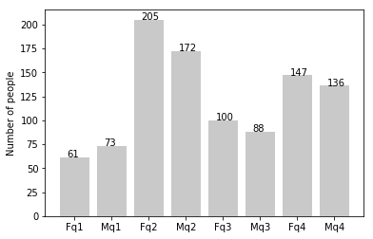
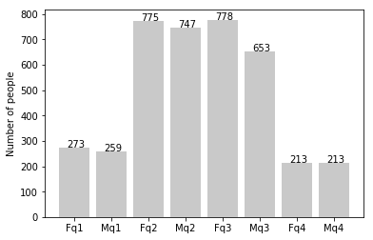
Data Exploration
Customer’s Age Distribution
As we can see, our new customers are mostly in the age of 25-48 years old.
Number of customers from 48-59 years have big drops on percentage.
There is a slight increase in number of customers over 59 years age in terms of percentage.
It looks like the percentage of people below 25 years of age does not really change.
New
Old

Slide 5
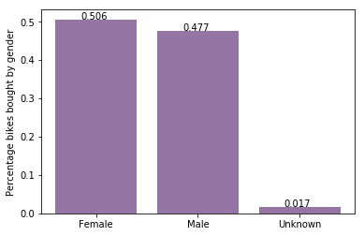
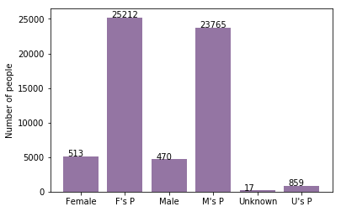
Model Development
Bike purchases last 3 years
As we can see our new customers, are mostly females with 50.6% purchases with a total of 25,212 bikes.
Males contribute to 47.7% purchases with 23,765 bikes.
So we should focus on advertising for female customers rather than male customers.

Slide 6
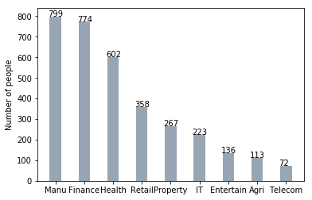
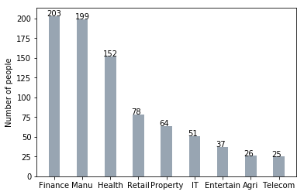
Interpretation
Job Industry Category
Mostly our new customers are in the finance industry and our manufacturing customers are still in the top 2.
The remaining industries are still the same.
New
Old

Slide 7
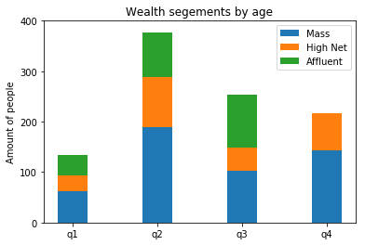
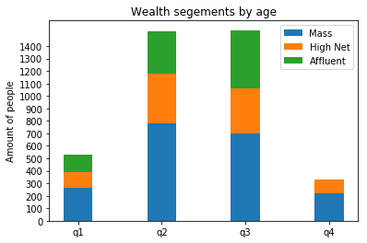
Interpretation
Wealth segments
In all ages, the number of mass customers is the highest so we should focus on this social class.
After that, we should focus on High Net customer.
Then we should focus on Affluent customers but mostly in the second and third quadrant.
New
Old

Slide 8
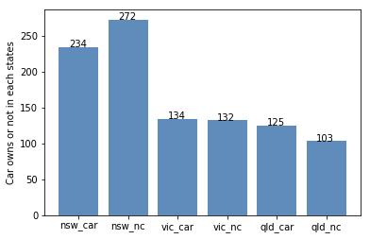
Interpretation
Numbers of cars owned
NSW should be considered the most since number of customers who don’t own cars are significantly larger than the ones who own a car.
VIC and QLD has more customers who own cars as compare to those who don’t. Instead, we can try to add some other thing for those who don’t own cars can buy bikes.

